Slide 1
Minimizing Stimulation Artifact in Real-Time Movement Decoding
Nathan Griffin
Mentor: Dr. Mark Brinton

Slide 2
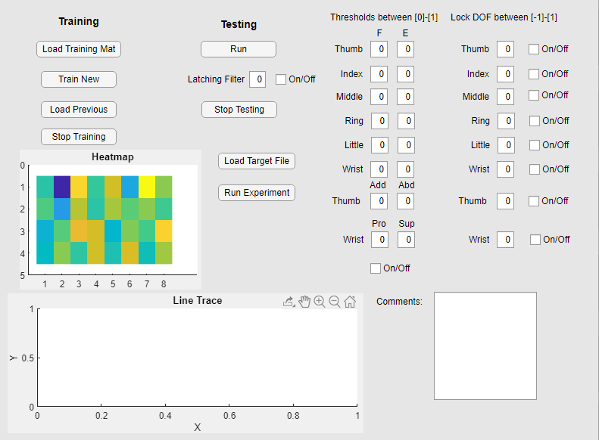
Control Virtual Hand with Muscle Signals
Stream EMG
Calculate Features
Predict Using Kalman Filter
Send Movements to Virtual Hand
Notes:
Stream raw EMG from the sleeve
Send the raw EMG through the Kalman filter to get position of the hand
Send the position of the hand to the virtual hand
Latching filter- make the movement smoother by filter out small changes in position
Thresholds- remove jittery movements when the hand is at rest.
Lock DOFs- lock a DOF at a certain position

Slide 3
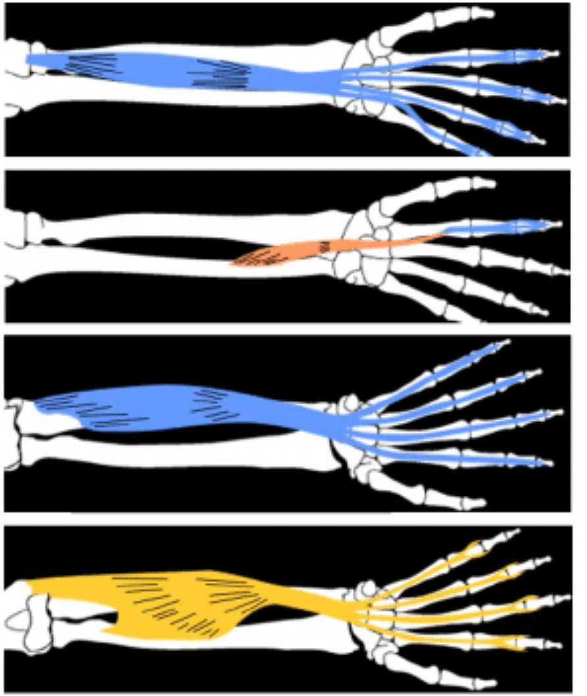
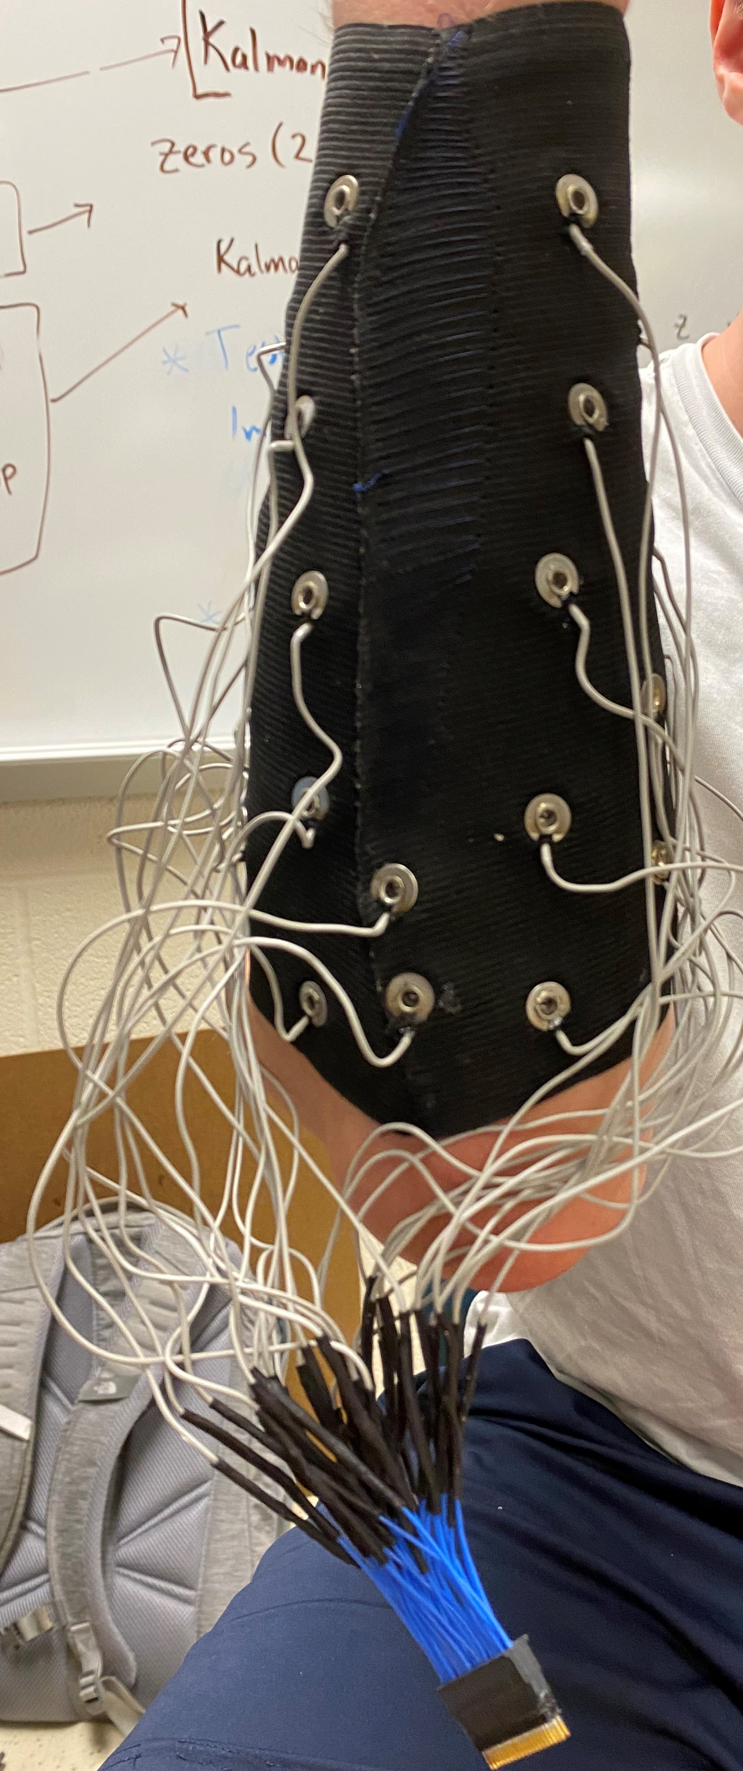
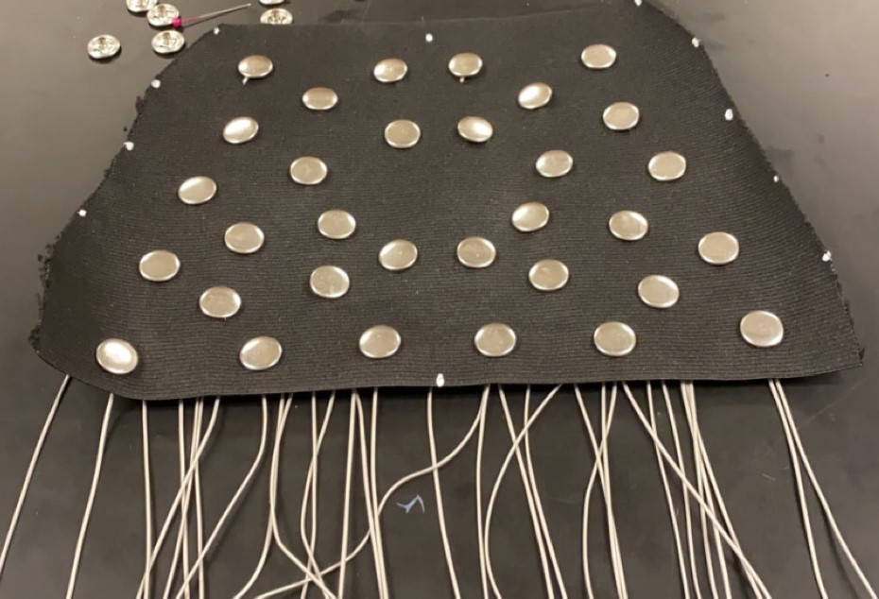
32 Electrode Sleeve Records Muscle Signals
Electromyography(EMG)
Notes:
Ulna

Slide 4
Low Cost, High Voltage Stimulator for Sensory Feedback
1cm
Return Electrode
Active Electrode
Converts 0-5V pulses to 0-11mA
High Voltage Converter (±150V)

Slide 5
High Voltage Stimulation Corrupts EMG Stream

Slide 6
Ways to Reduce Artifact When Operating Hand with Stimulation
Which algorithm minimalizes stimulation artifact?
Does training with stimulation reduce artifact?
Algorithm
Kalman Filter
Convolutional Neural Network

Slide 7
Convolutional Neural Network Design
9
Notes:
The CNN was trained using a Stochastic Gradient Descent with Momentum solver with an initial learning rate of 0.001. The CNN architecture (Fig. 2) consisted of a single convolutional layer, two fully-connected layers, ReLu activation between layers and a regression output. A 1x5 kernel was used for convolution, such that the convolution was only across time and not across the feature set. A total of 10 convolutional filters were used to produce a Nx6x10 output feature map. The output of the convolutional layer was then passed through a ReLu activation layer before being passed to the first fully-connected layer. The output of the first fullyconnected layer was also passed through a ReLu activation layer before being passed to the second fully-connected layer. Both fully-connected layers consisted of 2N neurons, and thus the total size of the network depended on the number of input features used. The output of the second fully-connected layer was then fed into a final fully-connected layer that produced a total of 9 regression outputs, only which 6 were used in our case.

Slide 8
GUI to Run Experiment

Slide 9
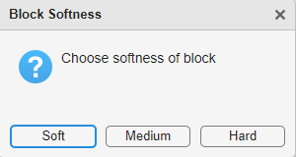
Kalman Filter Trained without Stimulation: Finger Recoil

Slide 10
Neural Network Trained without Stimulation: Finger Recoil

Slide 11
Training with Stimulation

Slide 12
Kalman Filter Trained with Stimulation: No Recoil

Slide 13
Neural Network Trained with Stimulation: No Recoil

Slide 14
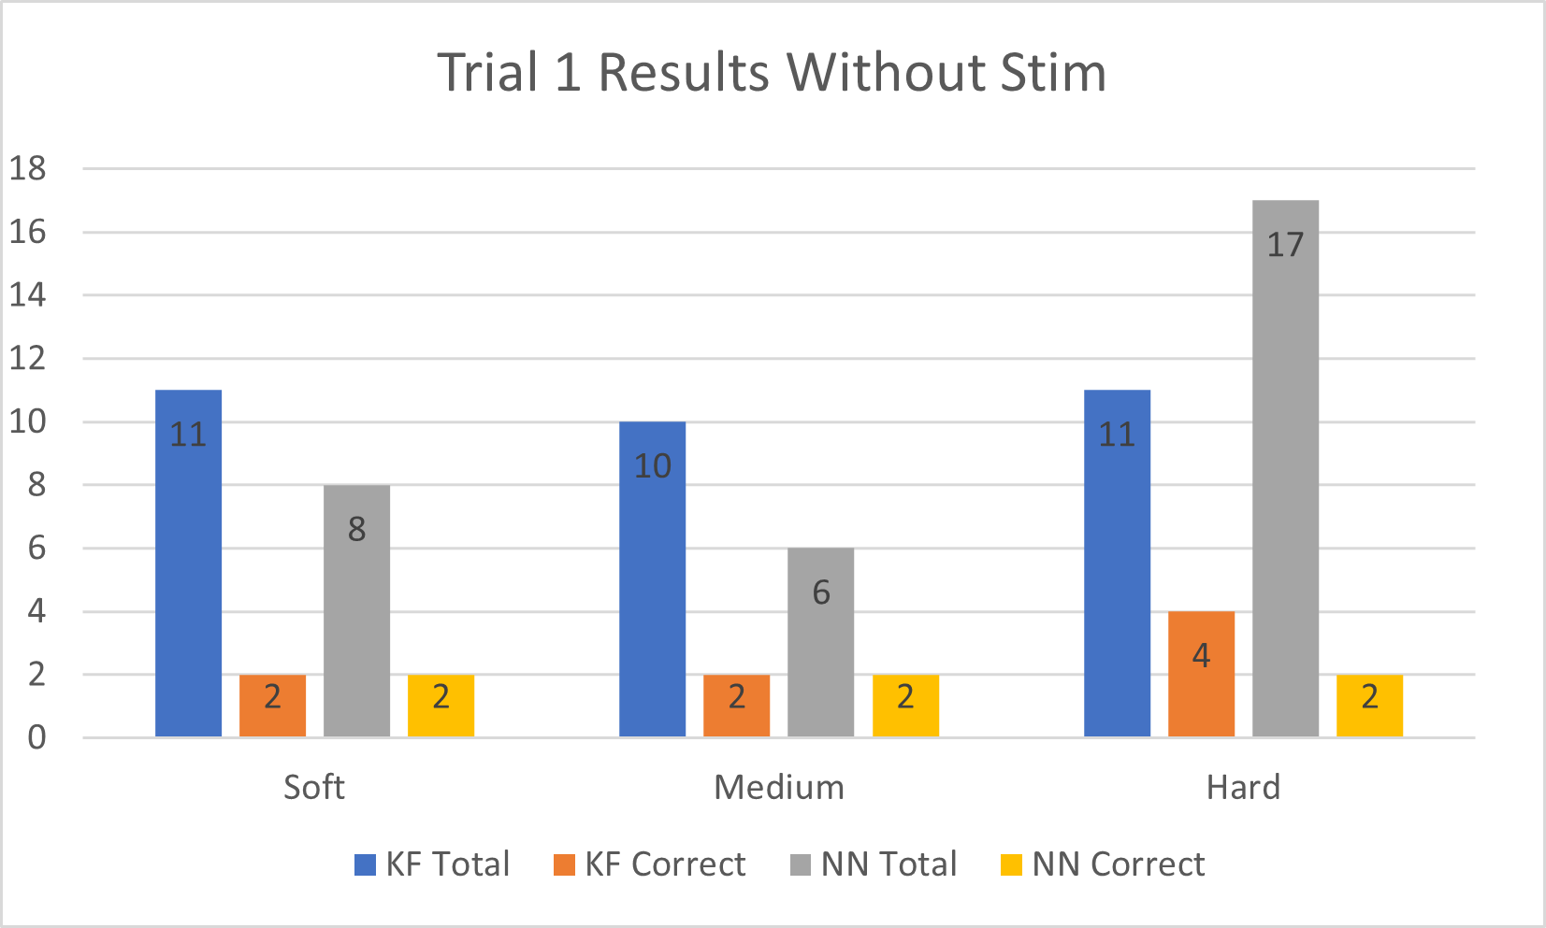
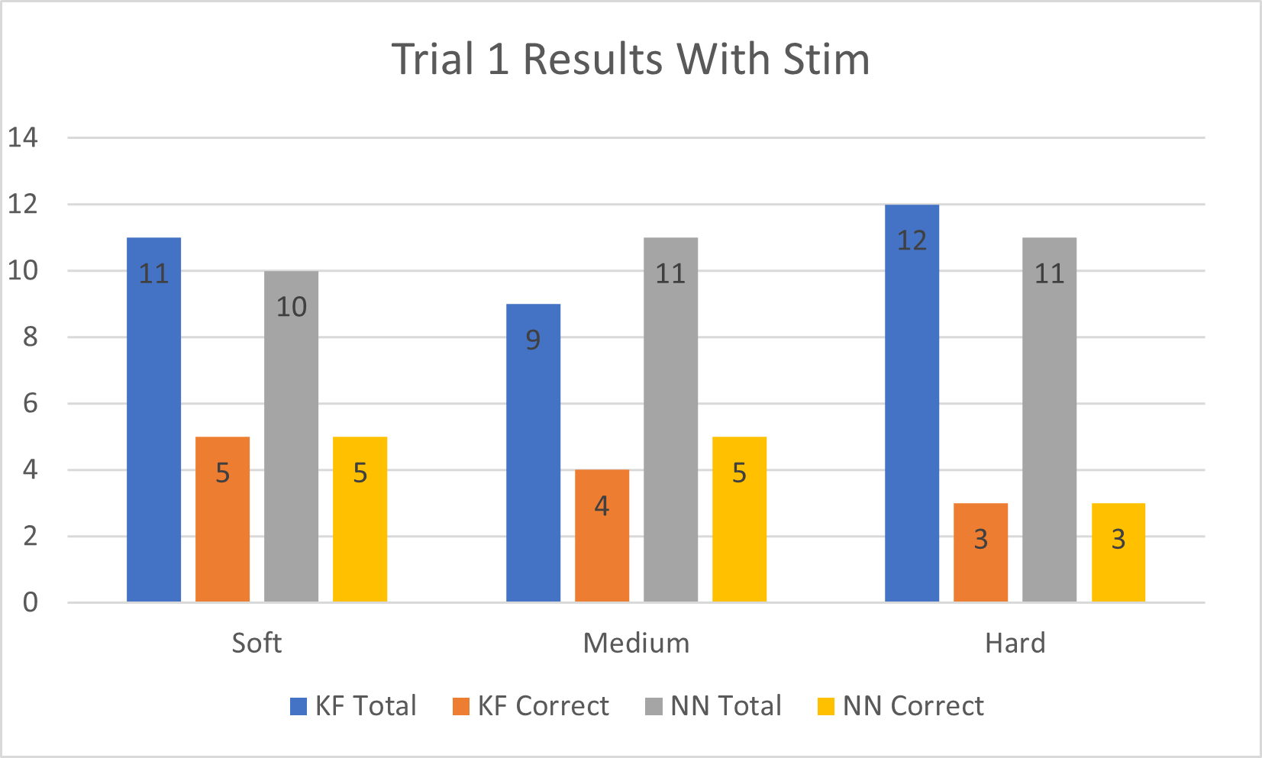
Training with Stimulation May Help Detect Softness
Stim causes artifact
Training with stim may improve your ability to detect softness
Pilot testing suggests that we may need to make changes to our experiment such as a wider difference between blocks.
Notes:
With Stim Without Stim
KF % NN% KF% NN%
Soft- 45% 50% 18% 25%
Med-44% 45% 20% 33%
Hard- 25% 27% 36% 11%

Slide 15
Record EMG to Train Virtual Hand
Mimic Virtual Hand while Recording EMG
Calculate Features (Mean-Absolute Value)
Align Features and Positions
Choose 48 Features
Train Steady State Kalman Filter
Notes:
Mimic virtual hand
Position is extension and flexion
Find MAV of EMG recordings from the buffer (Feature)
Smooths out noisy data
Once the training is complete, the data is aligned
Correlation between kinematics (features) and movements
Gram-Schmidt Forward Selection
Looks for the top 48 most useful features
Throw out any neural channels that would throw off channel selection
Find Steady-State using Kalman filter
Voltage- muscle activity
1 feature have 528 possible and choose 48 best

Slide 16
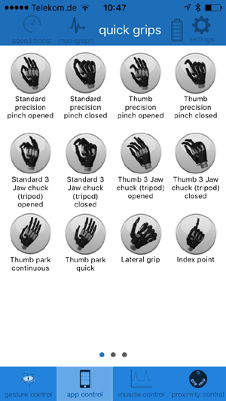
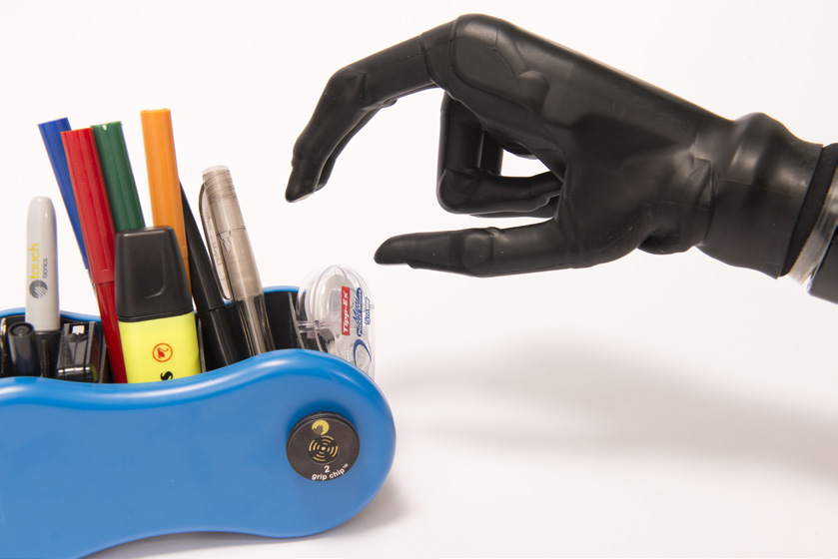
Current Prostheses Limit Natural Control for Reliability
Notes:
Most multi-articular hand prostheses allow the user to control a prosthetic through a range of pre-determined grip patterns with fixed force outputs. Although these pre-determined movements can make the prosthesis more reliable, user commands are limited to these grips and cannot be controlled naturally in real-time. However, by implementing a modified Kalman Filter, upper limb amputees can intuitively direct hand prosthesis with independent and proportional control.

Slide 17
Graphical User Interface (GUI) to Facilitate Training
Notes:
Load up to 8 DOF
Starts training
Heatmap shows features for the 32 electrodes in real-time

Slide 18
Kalman Filter Predicts New Positions from Current Features
Calculated From Training
Predicted Position at Current Time
Physics Model
Previous Position
Kalman Matrix
[DOFs × 48]
Features at Current Time
[48 × 1]
DOFs = Degrees of Freedom
Notes:
Z is 48 X 1 because of 48 chosen by Gram-Schmidt
Kalman Matrix 6 X 48 (Number of DOF’s by length of Gram-Schmidt)
Gamma: physics model set to one but could take other values (takes angular velocity of movement to predict position of next movement.)
X (t-1) is the last/previous position of the hand
X(t) new position of the hand

Slide 19
Kalman Filter Predicts New Positions from Current Features
From Training
Predicted Position
Physics Model
Previous Position
Kalman Gain
sEMG Features
DOFs = Degrees of Freedom
Notes:
Z is 48 X 1 because of 48 chosen by Gram-Schmidt
Kalman Matrix 6 X 48 (Number of DOF’s by length of Gram-Schmidt)
Gamma: physics model set to one but could take other values (takes angular velocity of movement to predict position of next movement.)
X (t-1) is the last/previous position of the hand
X(t) new position of the hand

Slide 20
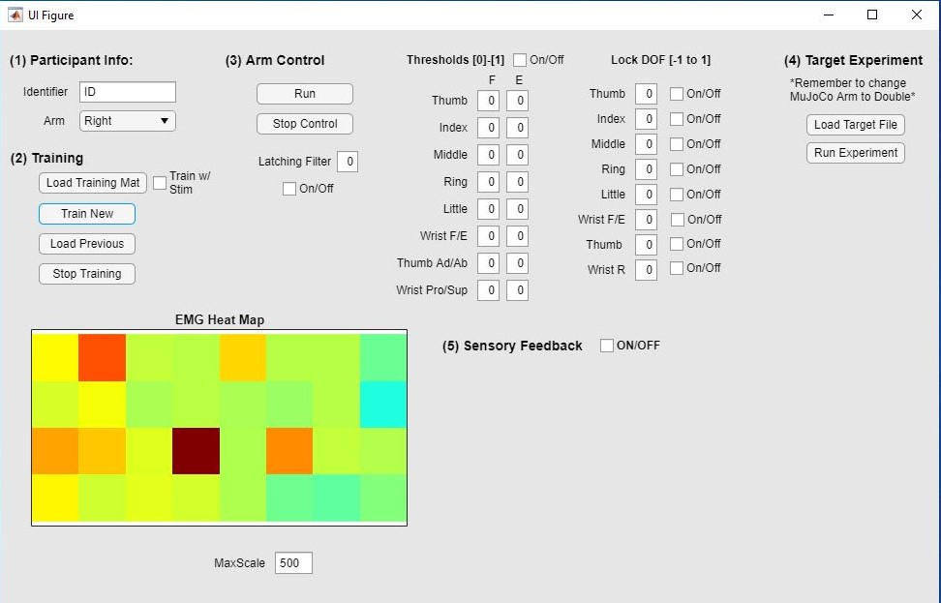
Future Work
Incorporate neural networks
Sensory feedback with force sensors
Improving algorithms to ignore electrical noise from stimulation

Slide 21
References
Brinton MR, Barcikowski E, Davis T, Paskett M, George JA and Clark GA (2020) Portable Take-Home System Enables Proportional Control and High-Resolution Data Logging With a Multi-Degree-of-Freedom Bionic Arm. Front. Robot. AI 7:559034. doi: 10.3389/frobt.2020.559034
George, J.A., Neibling, A., Paskett, M.D. and Clark, G.A., 2020. Inexpensive surface electromyography sleeve with consistent electrode placement enables dexterous and stable prosthetic control through deep learning. arXiv preprint arXiv:2003.00070.
https://www.researchgate.net/figure/Muscles-controlling-the-movement-of-the-index-finger-This-picture-is-adapted-from_fig6_23953710
i-Limb Access Other.pdf (ossur.com)
https://rippleneuromed.com/ripple-products/quest-hd-eeg/

