Slide 1
Exploring the effects of nicotine on reward learning in female Sprague-Dawley rats
Brendan Atticks
Elizabethtown College

Slide 2
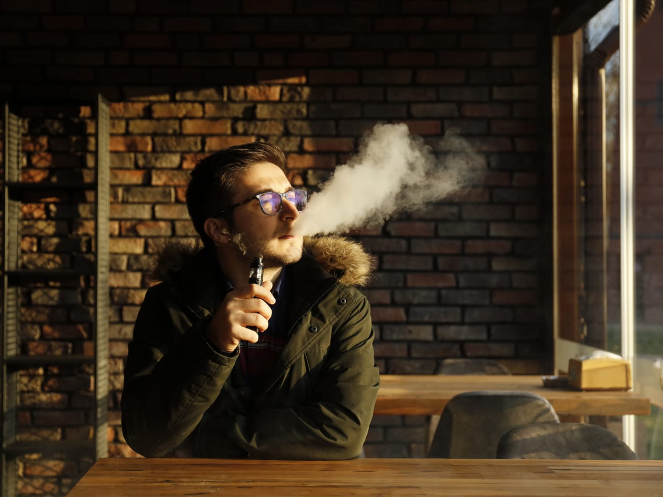
Rationale
Nicotine’s impact
Environmental cues and smoking

Slide 3
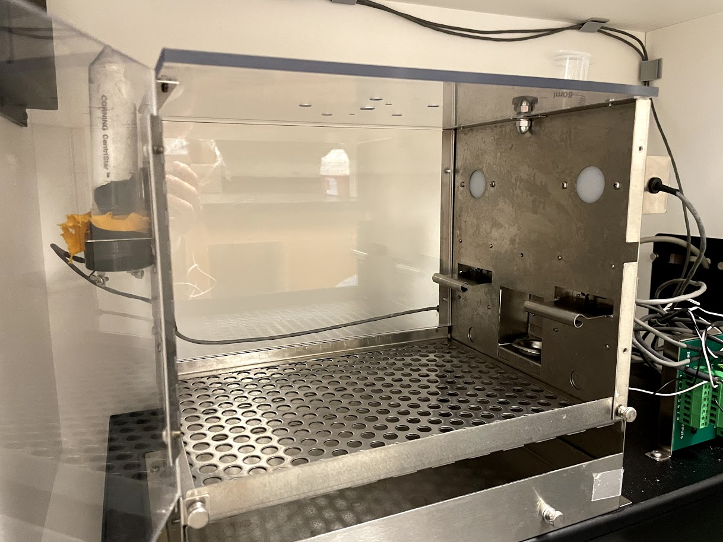
Cue-Induced Reward-Seeking
Training for sucrose self-administration – 1 hr./day, 10 days
Press lever
Audiovisual cue
Liquid sucrose reward
Timeout period
Cycle restarts
Cue-seeking test day
Notes:
One way in which we study….

Slide 4
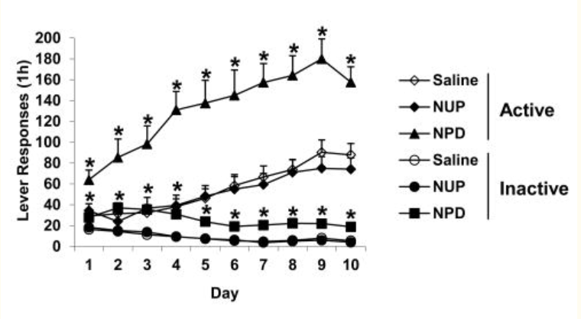
Rationale
Grimm et al.’s behavioral assay
Female rats
Focusing on training rats to self-administrate sucrose
(Grimm et al., 2012)

Slide 5
Optimization
Robust sucrose self-administration
Notes:
Current stage

Slide 6
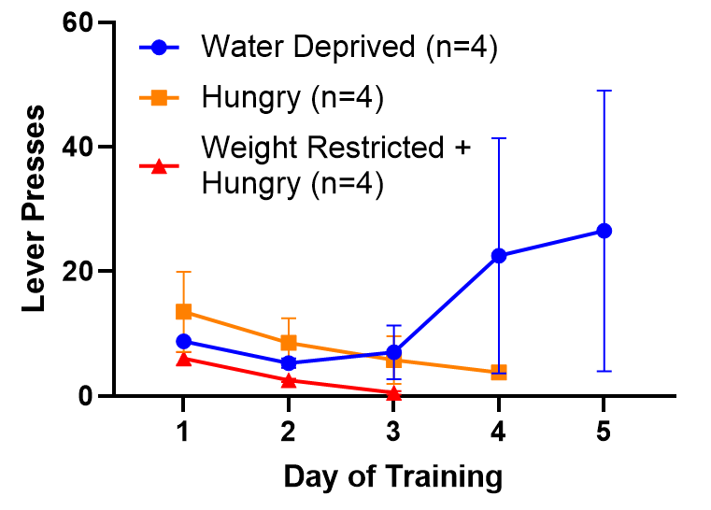
Optimization for Self-Administration
Deprivation
Water deprivation
Food restriction
Weight-restricted food deprivation
Notes:
85-90 percent weight restricted
Try another avenue to help the rats learn

Slide 7
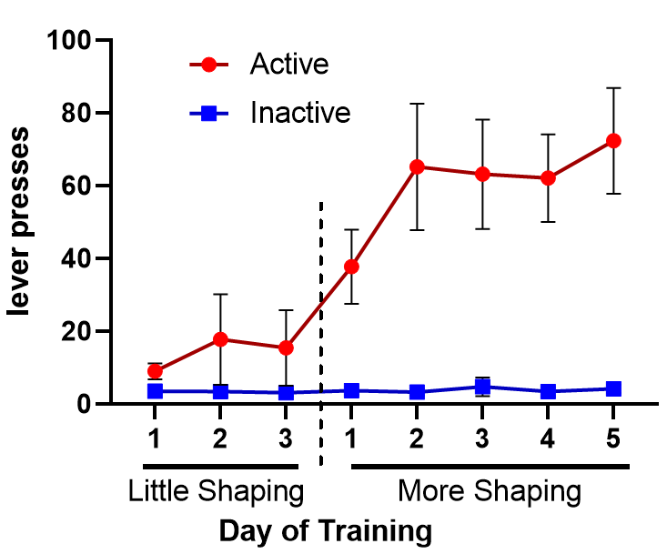
Shaping
Shaping – All water deprived, off deprivation with strong response
Baiting of lever
Help with triggering lever
Notes:
Shape more heavily

Slide 8
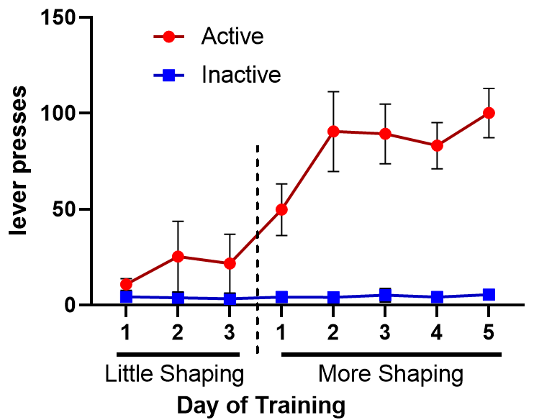
Shaping
Data with self-administrating rats only
Data robust enough to move on
Anova
Notes:
Difference more dramatic when untrainable rats removed from data

Slide 9
Further Study
Next steps

Slide 10
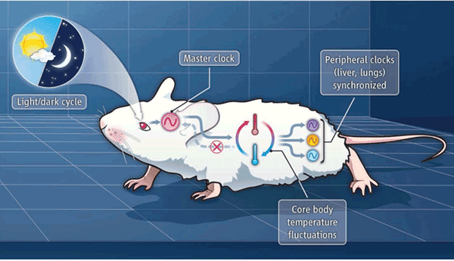
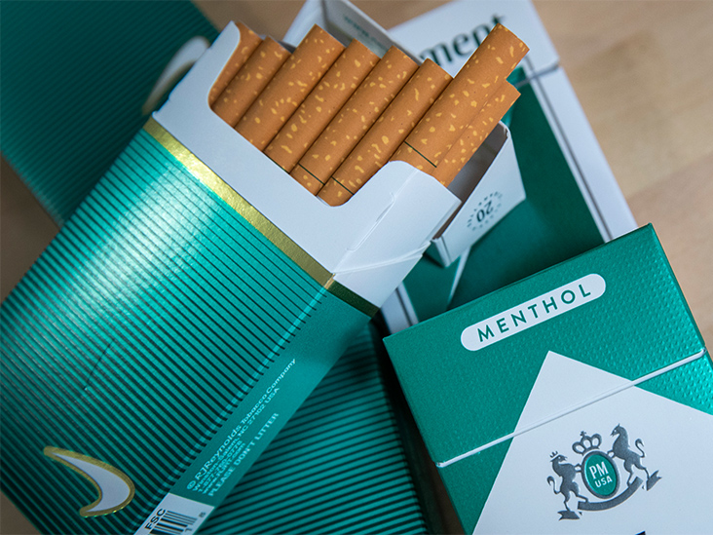
Further Study
Coming weeks
Dark-light cycles
Autoshaping
Nicotine
Menthol

Slide 11
Questions?
Thank you!

